Slide 1
Comenius Proyect in Italy
By:
The Spanish students

Slide 2
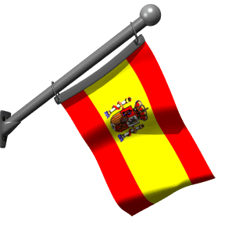
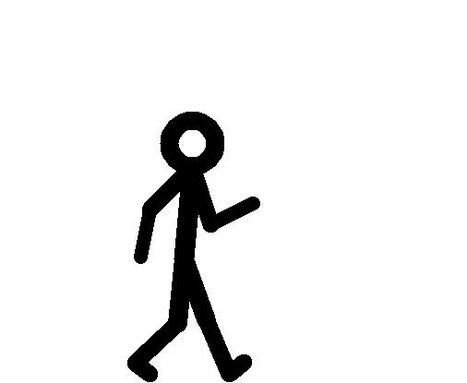
The exchanges
Valentina
Riccardo
Marcos
Victoria
Eleonora
Silvia
Fabrizzio
Andrés
Sandra
Irene

Slide 3
Victoria and Valentina

Slide 4
Marcos and Riccardo

Slide 5
Sandra and Eleonora

Slide 6
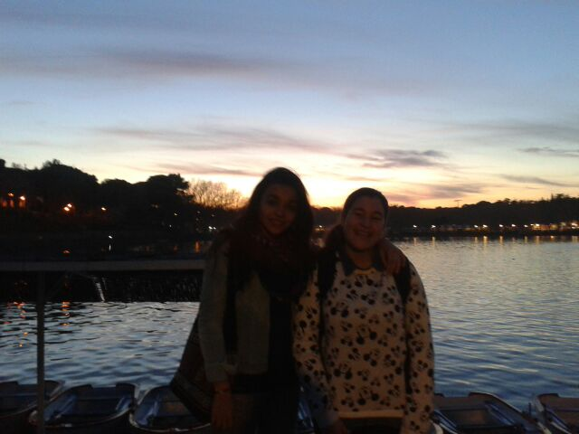
Irene and Silvia

Slide 7
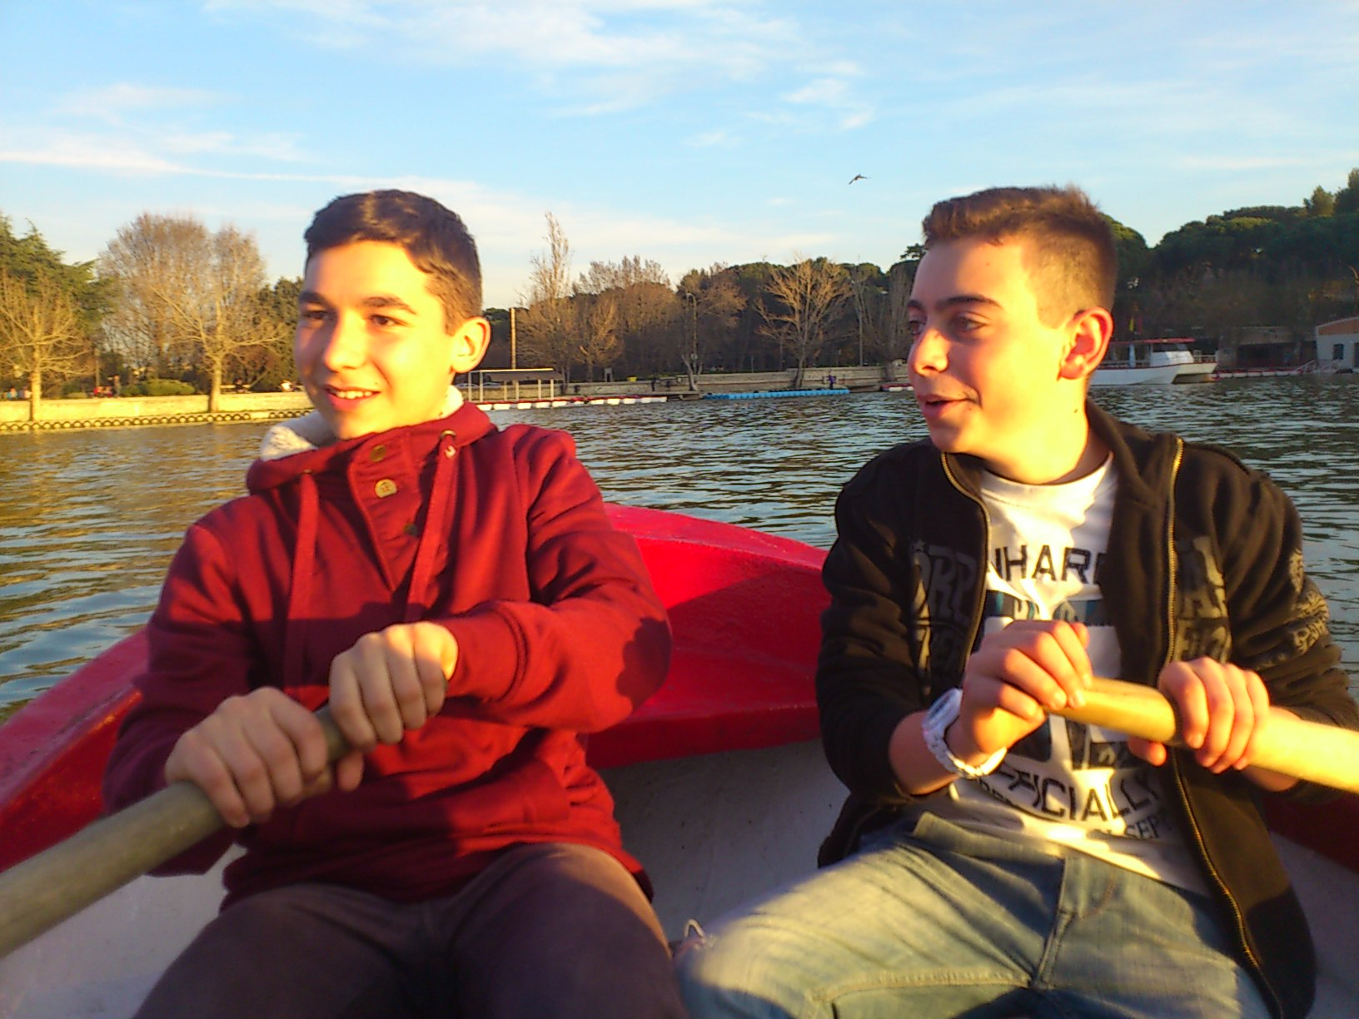
Andrés and Fabrizzio

Slide 8
Sightseeing
St. Peter’s Basilica

Slide 9
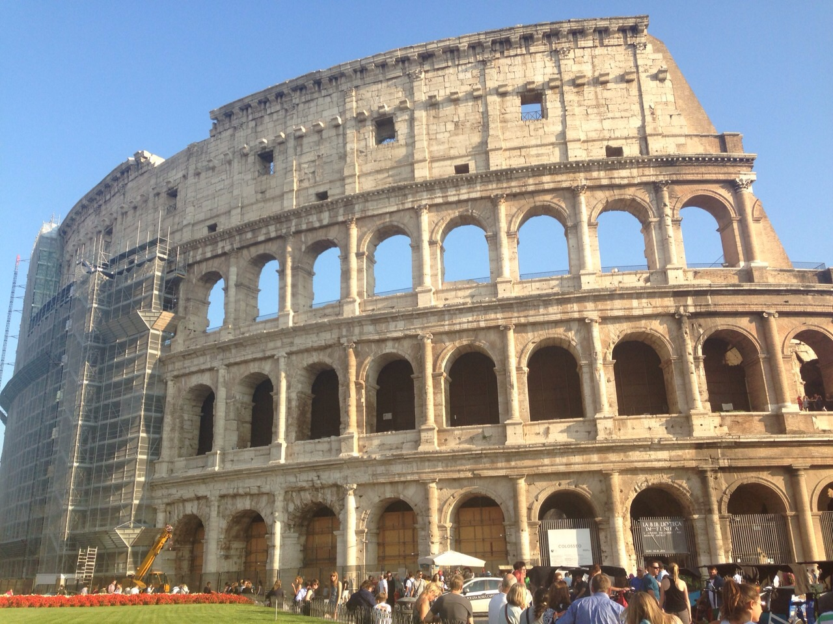
The Colosseum

Slide 11
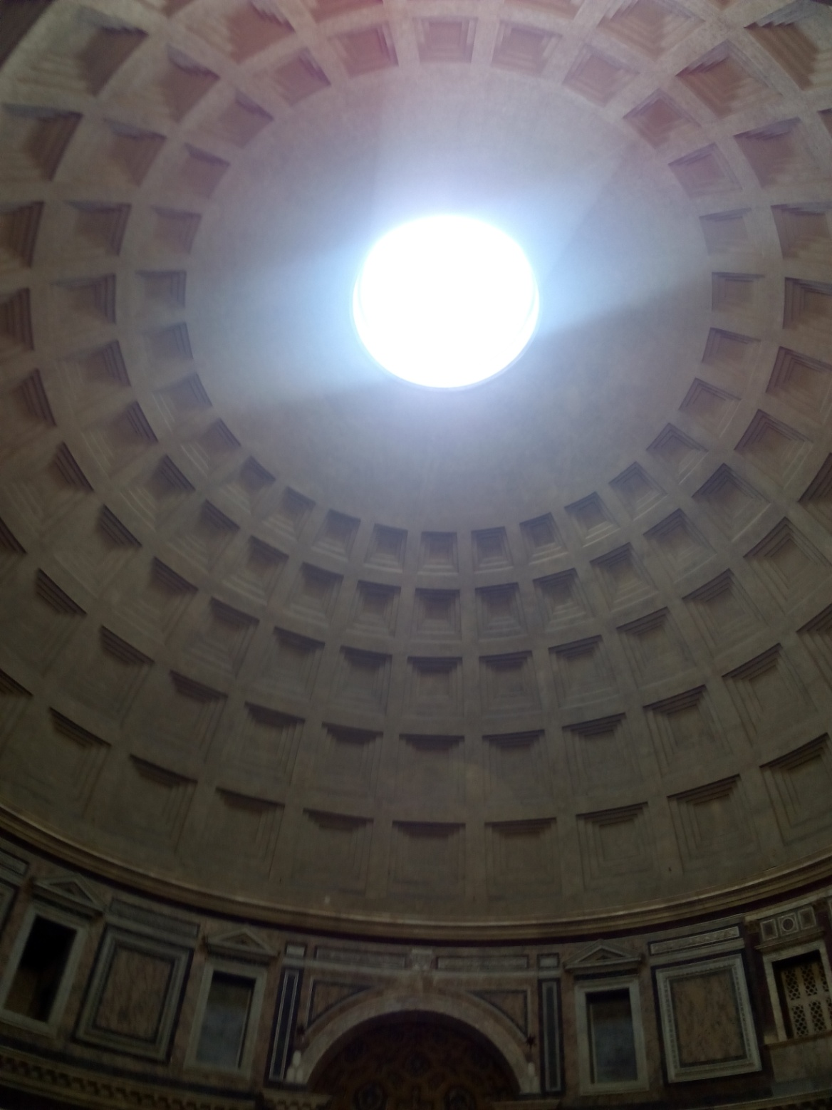
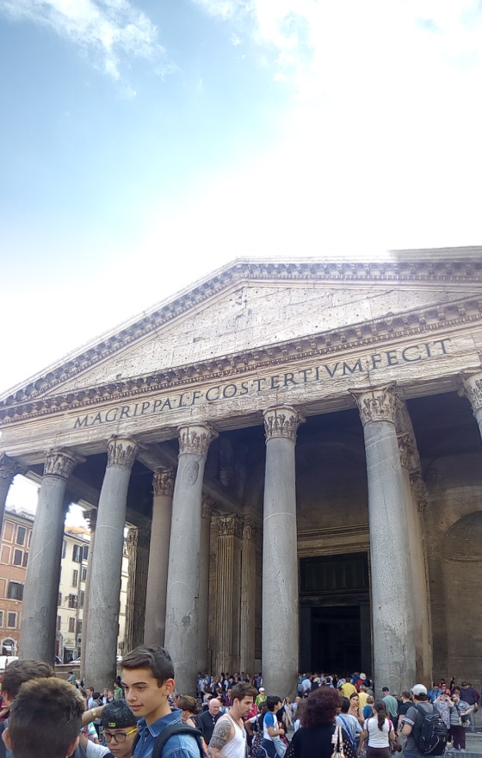
The Pantheon

Slide 12
Group activities

Slide 13
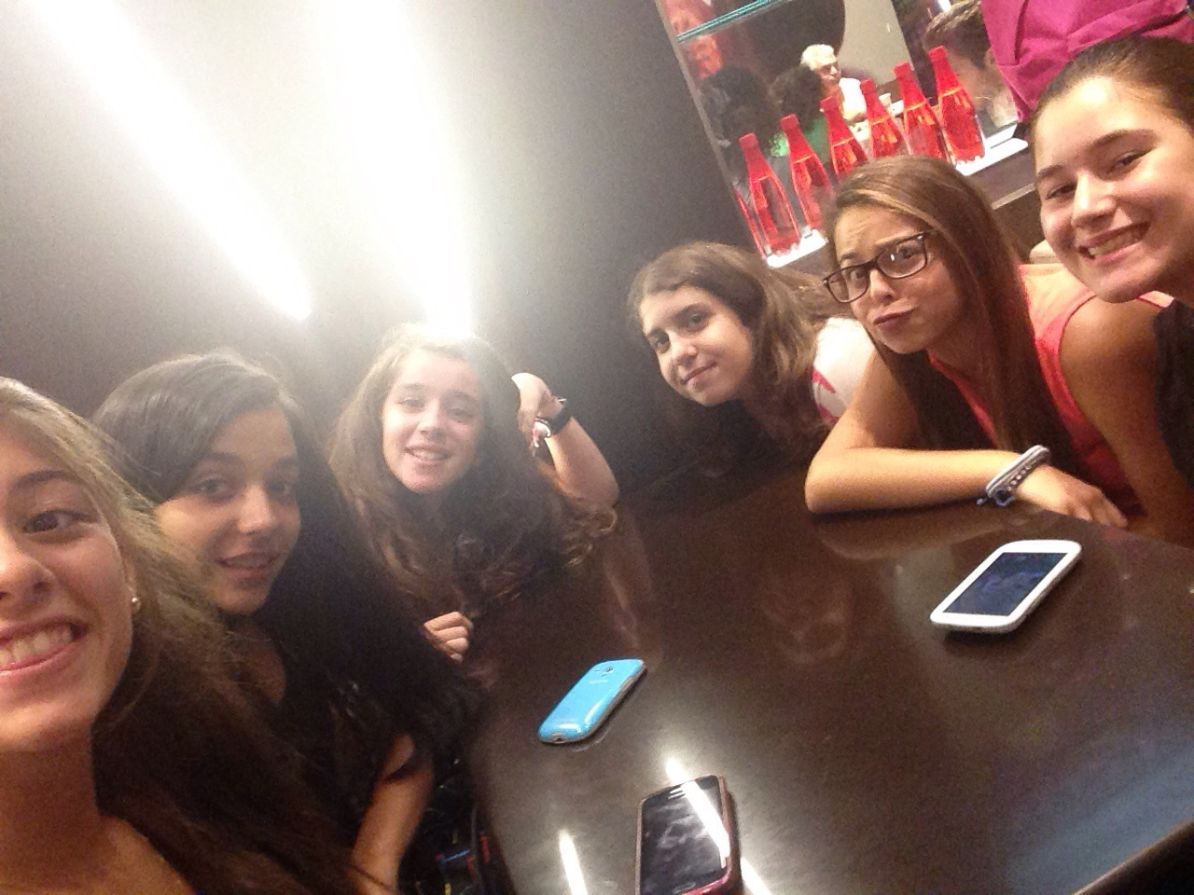
Girls in McDonalds

Slide 14
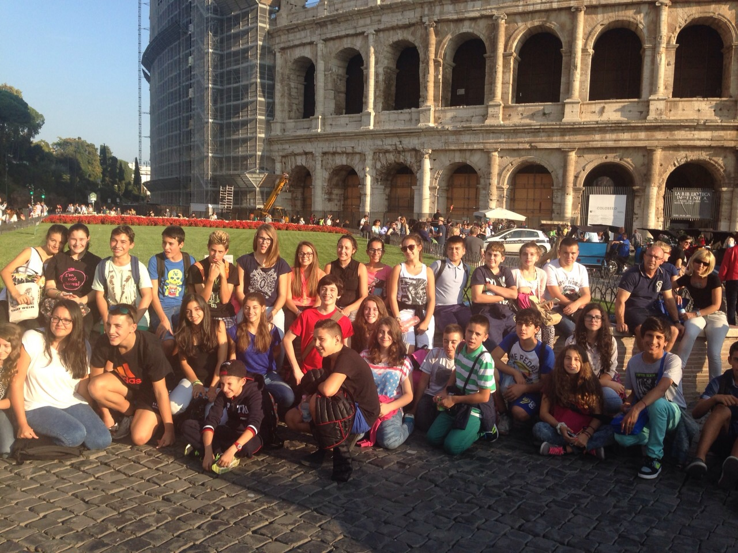

Slide 22
Victoria
Pier Luca
Andrés

Slide 23
Matteo
Marco

Slide 24
The end

